Slide 1
Extension Huddle
May 21, 2026

Slide 2
Today’s Huddle Talk
Dr. Varner on Extended Medical Leave
Good News Programming
Extension Disaster Education Network Update
PEARS Update and Expanded Leadership Team
PEARS Event Registration Module
Status of Cvent Registration System
Extension Professional Development Opportunities
2026-2027 Extension Educator Promotion Committees
Extension Positions in the Search Process
Rural Poll
Title II: Digital Accessibility Compliance Update
NACEB Summer Conference
Extension Huddle Extra

Slide 3
Dr. Varner on Extended Medical Leave
Dr. Varner underwent surgery on Monday and is recovering well.
Recovery timelines can vary, but his anticipated leave is approximately 5–10 weeks.
During his absence, for personnel and budget-related items, please work through your normal supervisory channels first and escalate to Dr. Charlie if needed.
To support his recovery time, please send cards to his home rather than contacting him directly by phone, text, or email.
  Mailing address: 1062 N. Linden St., Wahoo, NE 68066

Slide 4
Good News Programming

Slide 5
Extension Disaster Education Network Update

Slide 6


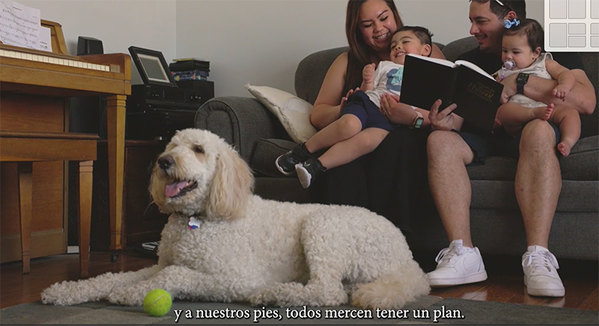
Disaster Education Is Built Into Our Work
Nebraska EDEN and Disaster Education isn’t new work.
It is a new way of seeing the work we already do and connecting those dots.
Every program area, every person in our organization contributes and it only take a small shift in our mindset to make the connection.

Slide 7

Disaster Education Is Built Into Our Work
All-hazards: Any threat or incident that can endanger life, property, or health.
Severe storms, drought, excessive heat, blizzards, fires, floods, earthquakes.
Economic and supply disruptions, cyberattacks, power outages.
Pandemics, foreign animal diseases, crop diseases, tick-borne diseases, health conditions.
Source: UNL Center For Agricultural Profitability

Slide 8
Disaster Education Is Built Into Our Work
Ask yourself
Did this program, activity, event or resource help people:
Plan ahead
Reduce risk and promote safety
Prepare for disruptions and change
Respond to challenges
Recover or adapt
One program - multiple Impacts:
Primary Program Area and/or role in your office.
Disaster Education
Strengthening extension’s capacity to provide education and outreach through collaborative networks in response to all-hazards emergencies and disaster events.

Slide 9
NE Role
Disaster Education Is Built Into Our Work
Examples:
4-H & Youth
Day Camp for Third Grade Youth.
  Reviewed safety protocols for youth including a risk assessment of the facility where the camp would be held.
  Taught youth how to make a go bag for pets.
Agriculture & Livestock Systems
Submitted an article on tax implications following a wildfire event.
Organized a webinar on government programs available to producers impacted by disaster events.
Attended a neighborhood meeting to help residents understand care of backyard flocks and preventing diseases.
Strengthening extension’s capacity to provide education and outreach through collaborative networks in response to all-hazards emergencies and disaster events.

Slide 10
NE Role
Disaster Education Is Built Into Our Work
Horticulture, Landscape, & Environmental Systems
Provided educational programs on mitigating risk from wildfires around the home landscape.
Developed information to residents on how to safely address damaged trees following a storm.
Answered questions from people concerned about contamination from flood waters impacting private wells.
Health & Wellbeing
Provided food safety information following power outages.
Presented an emergency preparedness program at the area Community Senior Center.
Helped families learn about low cost, no cost pantry items for their emergency kits.
Shared resources on stress and mental health and wellbeing following a disaster event.
Strengthening extension’s capacity to provide education and outreach through collaborative networks in response to all-hazards emergencies and disaster events.

Slide 11
NE Role
Disaster Education Is Built Into Our Work
Early Childhood
Helped a childcare facility develop an emergency plan and continuity of operations business plan.
Invited to speak at a preschool to share information and resources with teachers focused on helping young children practice calming strategies during and after stressful events.
Rural Prosperity Nebraska
Engaged with business to provide sessions on creating Continuity of Operations Plans.
Participated in a tabletop exercise organized by local organizations.
Worked with the area Ministerial Association to organize a program on active threats in places of worship.
Strengthening extension’s capacity to provide education and outreach through collaborative networks in response to all-hazards emergencies and disaster events.

Slide 12
NE Role
Disaster Education Is Built Into Our Work
Water & Cropping Systems
Presented a webinar on fire damage and impacts on crop residue.
Used a drone to assess damage to row crops following a major hail event.
Served as a guest panelist at the 2026 Yonts Water Conference the critical water situation in the North Platte Basin.
Offices & Units
Reviewed and submitted an Emergency Action Plan.
Invited the local Sheriff to talk about safety and active threats.
Shared information and resources on social media.
Ensured the office/vehicles have emergency kits and NOAA Weather Radios.
Held a fire drill, tornado drill
Provided and/or attended First Aid/CPR training/Stop the Bleed
Strengthening extension’s capacity to provide education and outreach through collaborative networks in response to all-hazards emergencies and disaster events.

Slide 13
Disaster Education Is Built Into Our Work
Ask yourself
Did this program, activity, event or resource help people:
Plan ahead
Reduce risk and promote safety
Prepare for disruptions and change
Respond to challenges
Recover or adapt
One program - multiple Impacts:
Primary Program Area and/or role in your office.
Disaster Education
Strengthening extension’s capacity to provide education and outreach through collaborative networks in response to all-hazards emergencies and disaster events.

Slide 14
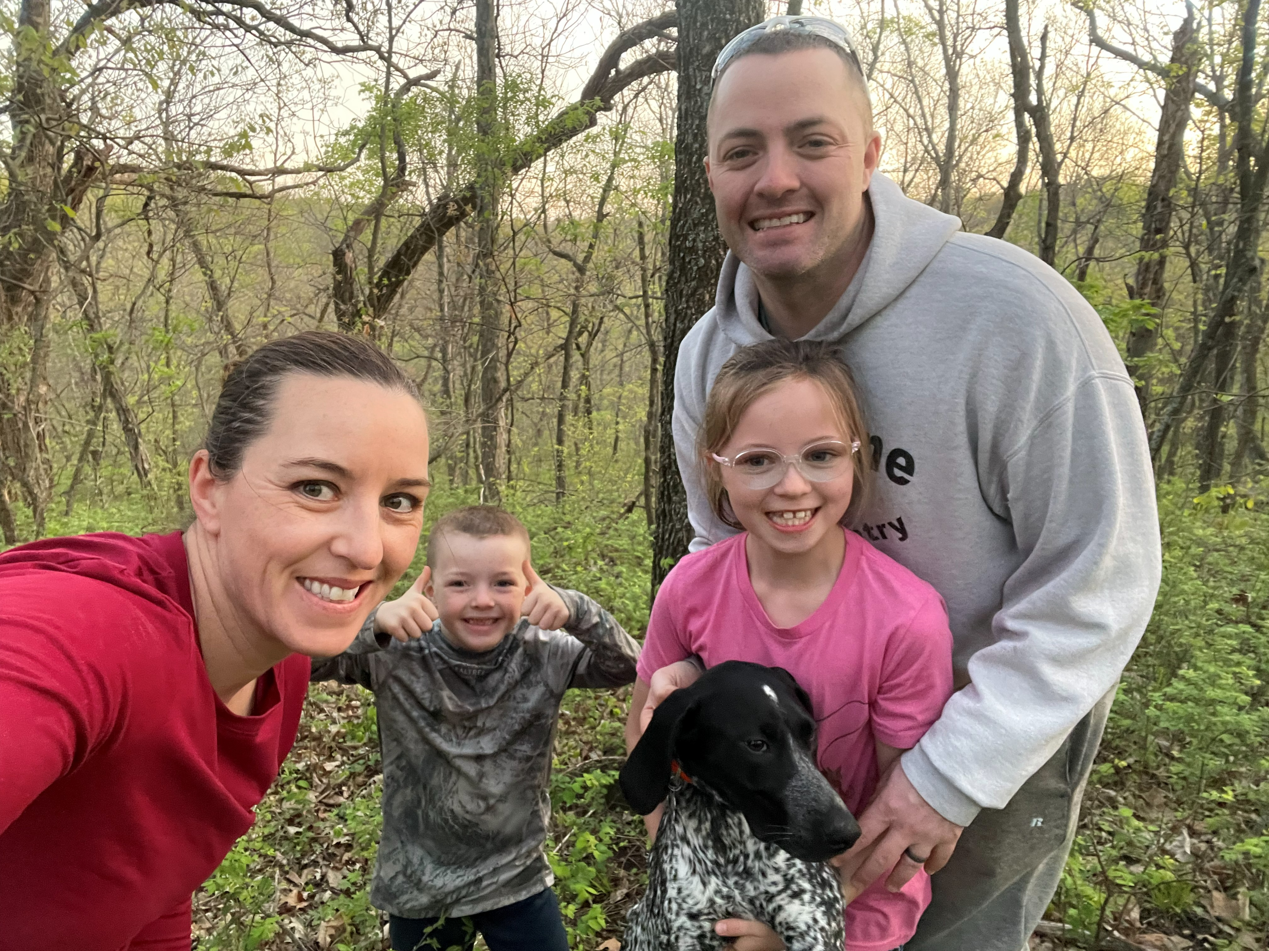
NE Role
Disaster Education Is Built Into Our Work
The work you do every day supports people, families, and communities through challenges, change, and uncertainty.
That’s Extension. That’s Nebraska EDEN. That’s Disaster Education.
Report your efforts.
Share your success stories.
Strengthen our collective impact.

Slide 15
NE Role
Thank you!
Soni Cochran, scochran2@unl.edu

Slide 16
PEARS Update and Expanded Leadership Team

Slide 17

PEARS Updates
May 21, 2026

Slide 18
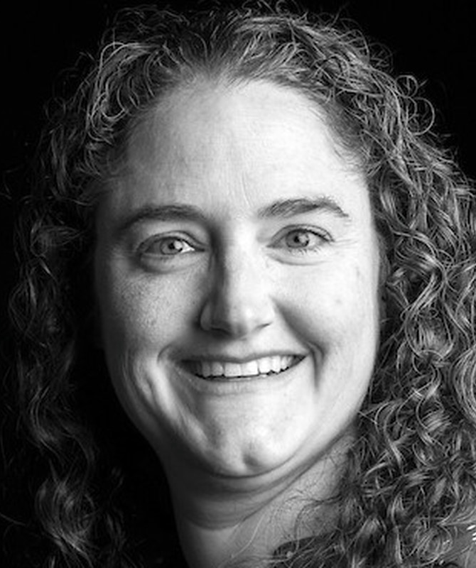
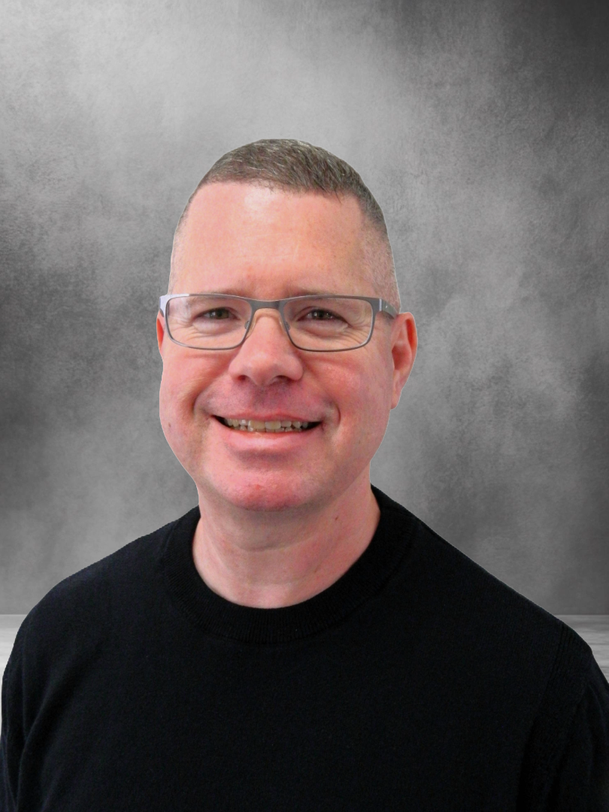
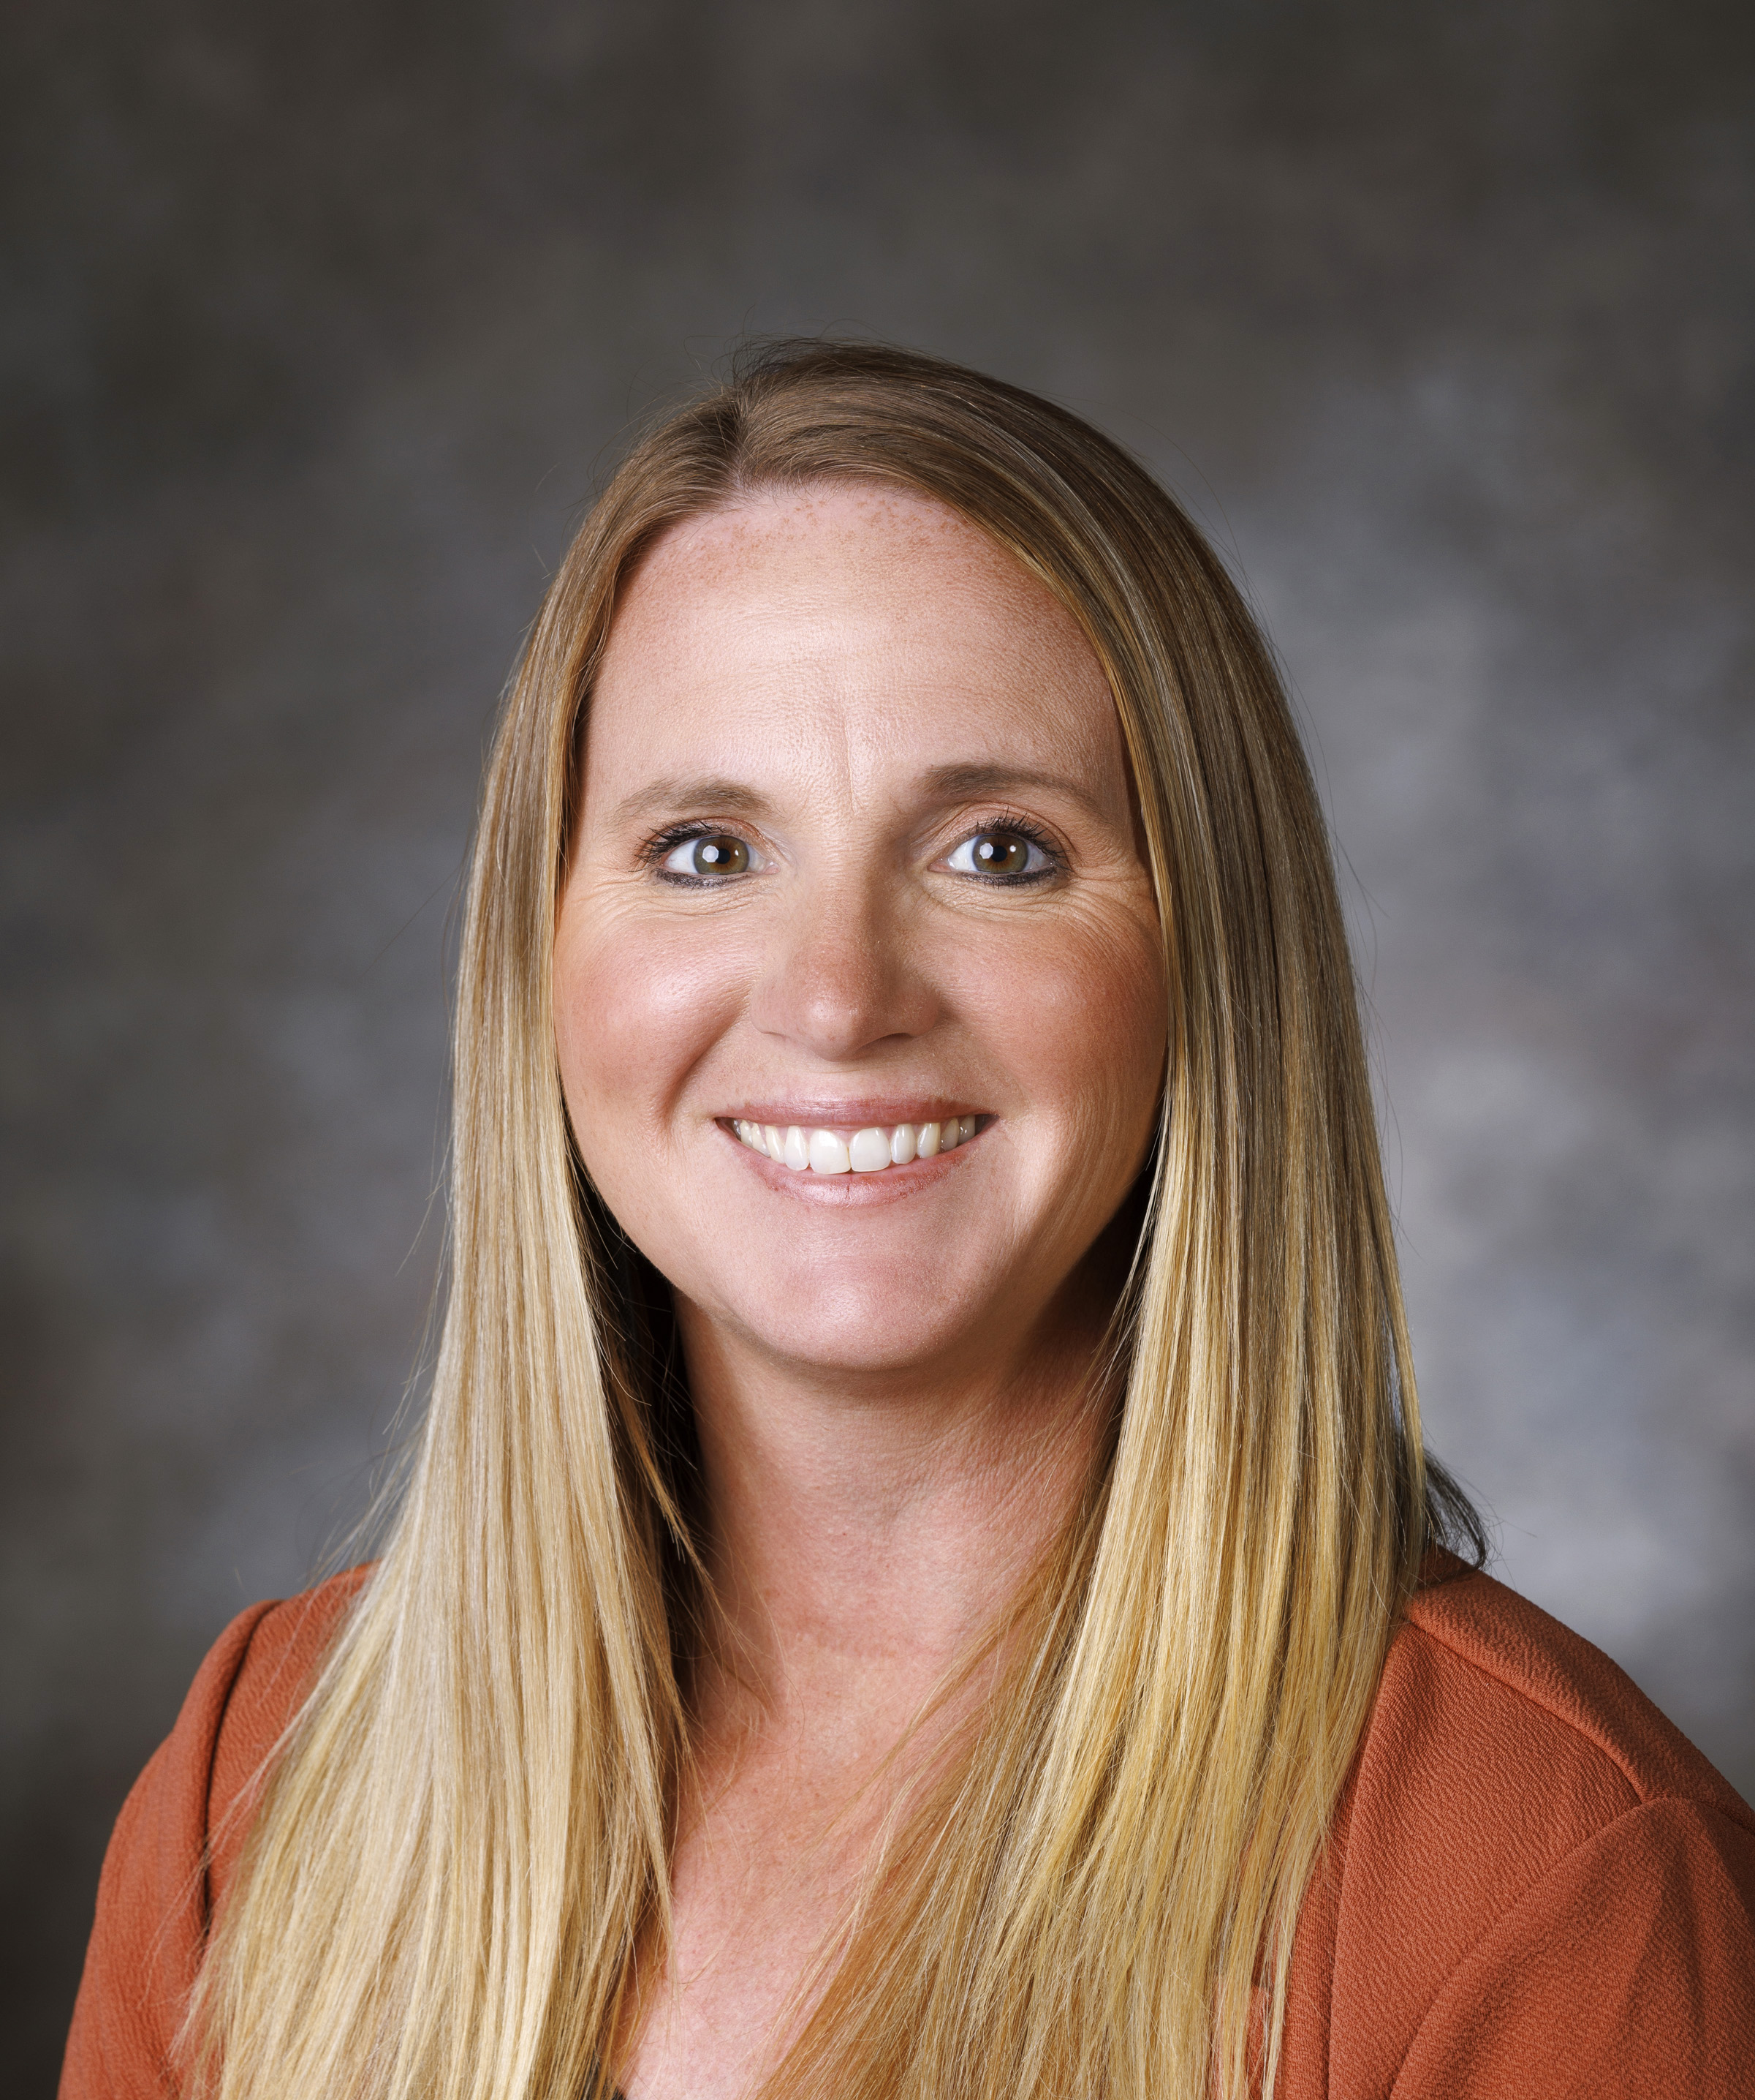
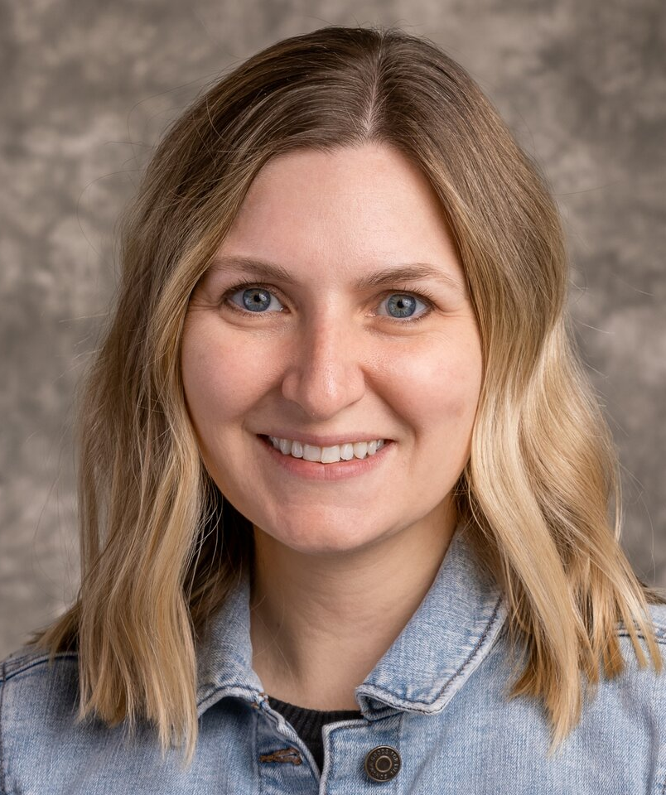
PEARS Leadership Team

Slide 19
PEARS Leadership Team Roles
Data Admin & Management:
Donnia
Data Analysis & Reporting:
Donnia
Training & Support:
Katie
System integration & enhancement:
John
Compliance & QA:
Katie

Slide 20
2026 PEARS Professional Development Series
11:00-11:45 am
17 Sep. 2026
Survey Results and Interpretation
15 Oct. 2026
PEARS User Dashboard
Year End Reporting
17 Dec. 2026
Topic TBD
12 Nov. 2026

Slide 21
Reporting Disaster Response and Recovery in PEARS
New Program Area in PEARS
  Disaster Education
  This includes all disaster-related education, response, and recovery activities.
For any wildfire-related activity, please:
  Select “Disaster Education” as a Program Area
  Also select your primary program area(s) (e.g., Health & Wellbeing, Livestock Systems, 4-H, etc.)
  Enter the activity in the appropriate PEARS module as usual (program activity, indirect activity, partnership, etc.)
  If you have previously made entries around the wildfires, please go back and ADD this program area to your entries.
Coming Soon:
  Apr-Jun Quarterly Effort Report, there will be a Disaster Education section.
  Please track your efforts now and keep them handy to be included when that piece is available in the next QER.

Slide 22
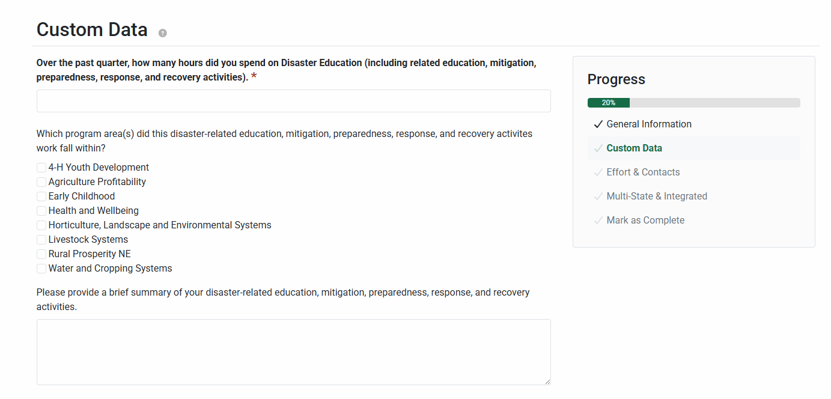
Reporting Disaster Response and Recovery in Quarterly Effort Report
Quarterly Effort Report
  Effective (Apr-Jun) Quarterly Effort Report, there will be a Disaster-Related Education section.
  Please track your efforts now and keep them handy to be included when that piece is available in the next QER.

Slide 23
Q: Where should Extension Board Meetings be entered into PEARS?
Extension Board meetings and similar governance or advisory meetings should not be entered as a Program Activity in PEARS.
Program Activities are intended for:
  Audiences outside of Extension
  In-depth educational programming
Examples include:
  Extension Board meetings
  4-H Council meetings
  County Board/Commissioner meetings
  Fair Board or Ag Society meetings
Previous guidance suggested that these meetings were entered as Program Activities so they could be connected to a Lead Educator Action Plan. However, Canopy now allows Action Plans to be linked to all PEARS modules, including Partnerships.
Going forward:
  Please enter these groups as Partnerships in PEARS.
  Create the board or council as a Partnership
  Track meetings and events within the Partnership module
  Tag applicable collaborators
  Link the Partnership to the appropriate Action Plan as needed
This approach more accurately reflects the purpose of these meetings while still allowing them to be documented and connected to Action Plans.

Slide 24
Resources and Communication
Resources and Communication
  A new resource page is under construction; existing content will be reviewed and incorporated if relevant.
  The new page will be organized using the menu structure utilized by the PEARS platform.
  Future content will be created from the lens of Nebraska Extension and supported by the PEARS Support knowledgebase links where necessary.
  Overarching goal of developing content that is role-specific and easy to navigate.
  A new email, pears@unl.edu was created to collect questions, support requests, and allow triaging by the PEARS Leadership Team.

Slide 25
Dates to Remember
Quarterly Effort Report:
  Apr – Jun: Due July 30
  Jul – Sep: Due Oct 30
  Oct – Dec: Due Dec 31
FY2026 Year End Deadline: December 31, 2026
  All entries in all modules, marked as complete.

Slide 26
PEARS Event Module

Slide 27
PEARS Event Module
Overview and Key Information
The PEARS event module is now active and enabled for all users with a cost of $3.00/registrant + 3% card processing fee. ​
The module can be used at no cost if your event does not have a fee to attend. ​
While events can be created by all users, publishing rights will remain restricted in the short-term to allow for adequate review and support correct input of accounting information and required non-discrimination and accessibility statements. ​
Changes or edits post publishing will require assistance from the support team (John Re, Laura Tharnish, Katie Larson), email pears@unl.edu for assistance.

Slide 28
PEARS Event Module
Updates
An issue was surfaced during the Event Module Webinar on April 29th concerning the visibility of registrant information.
The PEARS Leadership Team engaged Canopy to work through solutions.
An update was applied on May 20th that limits access to registrant information to event creators, collaborators, and system administrators.

Slide 29
PEARS Event Module
Resource and Event Links
MyExtension Site Resources
PEARS Event Module
Nebraska Extension Events

Slide 30
Status of Cvent Registraton System

Slide 31
Status of Cvent Registration System
Extension’s current contract with Cvent is set to expire at the end of 2026, and we will not be renewing. Cvent will no longer be available for 2027 program registrations.
We will be transitioning to the PEARS Event Module for accepting registrations. More info on the PEARS Event Module: https://go.unl.edu/pears_event_module
We plan to stop accepting payments in the Cvent system at COB on November 20th, 2026.
We can provide exports of any historical documentation you may need (registration reports, screenshots of registration pages, etc.) if requested prior to December 1. Reach out to Laura Tharnish (ltharnish2@unl.edu).

Slide 32
Extension Professional Development Opportunities

Slide 33
Extension Professional Development Opportunities
In Extension work, our impact is rooted not only in what we know, but in how we connect, communicate and lead.
Foundational professional development offerings, such as Emotional Intelligence, Fierce Conversations, The 7 Habits of Highly Effective People, Trust Edge, Coaching and Gallup Clifton Strengths, provide the essential skills needed to build those capabilities.
These frameworks help Extension professionals strengthen self-awareness, navigate complex relationships and engage effectively with communities. They equip us to manage change, lead with intention and communicate with clarity and purpose.
By investing in these core areas, we are not only enhancing our individual effectiveness, but also strengthening our ability to serve, collaborate and create meaningful lasting impact in our Extension careers and communities we support.

Slide 34
Fall Schedule
Trust Edge – October 10/11th
Fierce Conversations (Foundations) – September 15, 22, 29 & October 6th (1:30-3:30 Zoom)
The 7 Habits of Highly Effective People – October 7/8th
Coming in 2027 – Perfecting Your Presentation Skills, Leading with Friction, Facilitation
Coaching for Supervision – October 13/14th
Emotional Intelligence – TBA, Sept/Oct F2F, monthly zoom, Mar/Apr F2F

Slide 35
Shared Expectations for Learning
Register with Intention – if you sign up, plan to attend and fully participate.
Engage and Contribute – be present, reflect and practice during the sessions.
Be Open to Growth – come willing to learn, receive feedback and try new approaches.
Apply Your Learning – use these tools in your day-to-day Extension work.
Respect the Group – listen, value perspectives and maintain confidentiality.
Commit to the Process – complete what is asked for maximum growth opportunity.

Slide 36
Onboarding Team
Soni Cochran
Jenny Brhel
Tanya Crawford
Ashton Figgner
Emily Gratopp
Jaci Foged
Jennifer Hansen
Josie Crouch
Jen Epp

Slide 37
2026-2027 Extension Educator Promotion Committees

Slide 38
2026-2027 Extension Educator Promotion Committees
Chairs
4-H Youth Development – Beth Janning and Jennifer Epp
Ag and Natural Resources – Wayne Ohnesorg
Human Sciences – Ben Dutton
Campus/Statewide – Glennis McClure
4-H Youth Development Committee
Angela Apts (2027) F
Kerry Elsen (2028) A (newly elected)
Jennifer Epp (2028) F – Co-Chair
Jennifer Hansen (2029) F (newly elected)
Rhonda Herrick (2029) F (newly elected)
Beth Janning (2027) F – Co-Chair
Brett Kreifels (2027) A
Sarah Paisley (2027) A
Brandy VanDeWalle (2029) F (newly elected)
Ag and Natural Resources Committee
Ben Beckman (2028) A (newly elected)
Jenny Brhel (2029) F (newly elected)
David Lott (2028) F
Aaron Nygren (2029) F (newly elected)
Brent Plugge (2028) F
Wayne Ohnesorg (2027) F - Chair
Todd Whitney (2027) F
Human Sciences Committee
Kayla Colgrove (2027) F
Ben Dutton (2028) F - Chair
Hannah Guenther (2028) AO (newly elected)
Alyssa Havlovic (2027) A
Kayla Hinrichs (2027) F
Lisa Poppe (2029) F (newly elected)
Jackie Steffen (2027) F
Campus/Statewide Committee
Jill Goedeken (2027) (4H) F
Terri James (2029) (AG) F (newly elected)
Katja Koehler-Cole (2028) (AG) A (newly elected)
Glennis McClure (2027) (AG) F – Chair
Beth Nacke (2027) (HS) A
Tracy Pracheil (2027) (4H) F
Natalie Sehi (2027) (HS) F

Slide 39
Extension Positions in the Search Process

Slide 40
Extension Positions in the Search Process
New Extension Careers page
https://go.unl.edu/extension-careers
Extension Educator/Instructor
HWB Educator/Instructor – Hamilton County
Livestock Educator/Instructor – Brown County
EC Educator/Instructor – Dawson County
4-H Educator/Instructor – Washington County
4-H Educator/Instructor – Platte County
HLES Educator/Instructor – Scotts Bluff County
WCS Educator/Instructor – Adams County (coming soon)
4-H Educator/Instructor – Garden County (coming soon)
Extension Assistant
NEP Extension Assistant – Hall County
4-H Animal Science Extension Assistant – East Campus
4-H Extension Assistant – Scotts Bluff County

Slide 41
Nebraska
Rural Poll

Slide 42


Rural Poll Core Topics
Community
Well-Being
Demographics
Perceptions of community change
Satisfaction with community services
Attachment to community
Better or worse off compared to 5 years ago
Will be better or worse off 10 years from now
Feelings of powerlessness
Satisfaction with job, religion, family, community, clean water, etc.
Age
Spouse/Partner employment status
Marital status
Community size
Years lived in community
Employment status

Slide 43
Rural Poll Rotating Topics
2021
Trust and confidence in institutions
2022
Natural resource management (e.g., water)
2023
Civil discourse
2024
2025
Impacts of the pandemic
Leadership and volunteering in communities
Workplace and economy
Childcare
Farm Bill
Civil discourse
Economy and trade
Artificial intelligence
Housing
Energy resources and agriculture
Biosecurity and bioeconomy
Trust in institutions
Algorithms

Slide 44

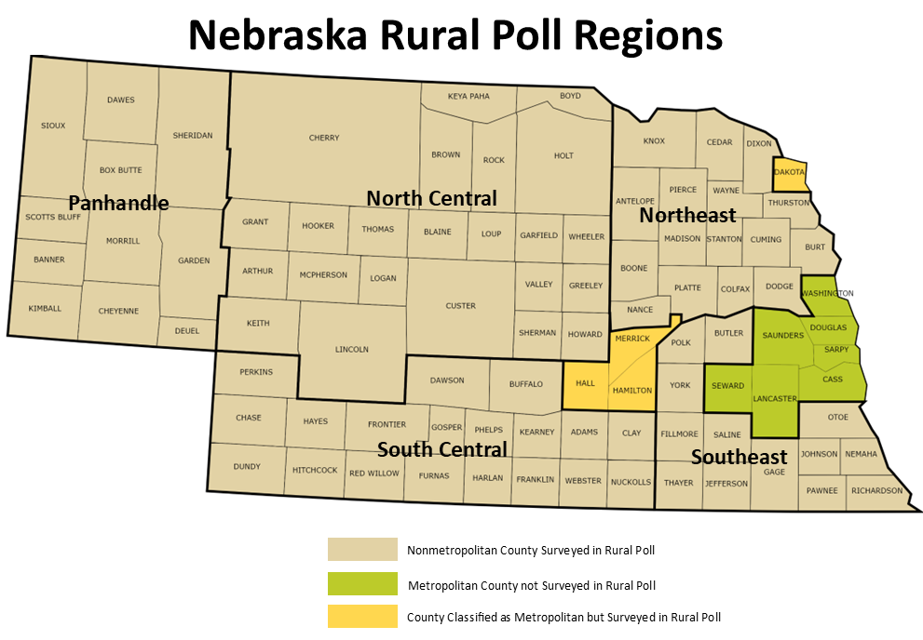
Sampled Counties and Regions

Slide 45
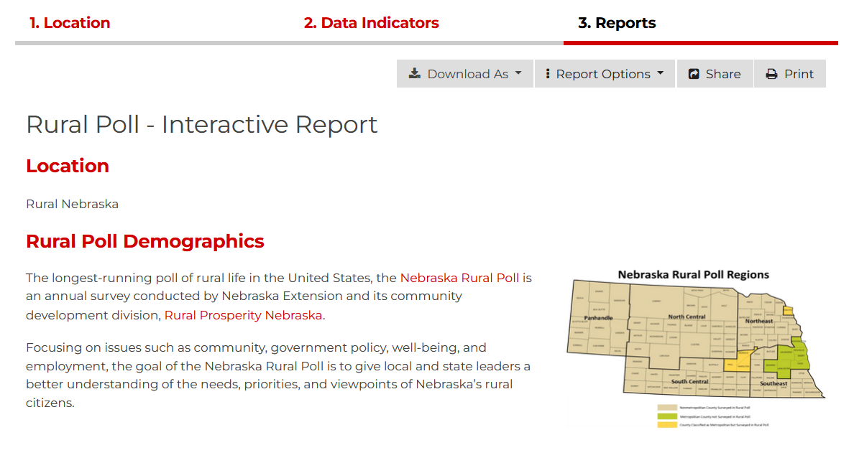

Nebraska Rural Poll: Interactive Report Tool
  https://go.unl.edu/ruralpolltoolatn

Slide 46
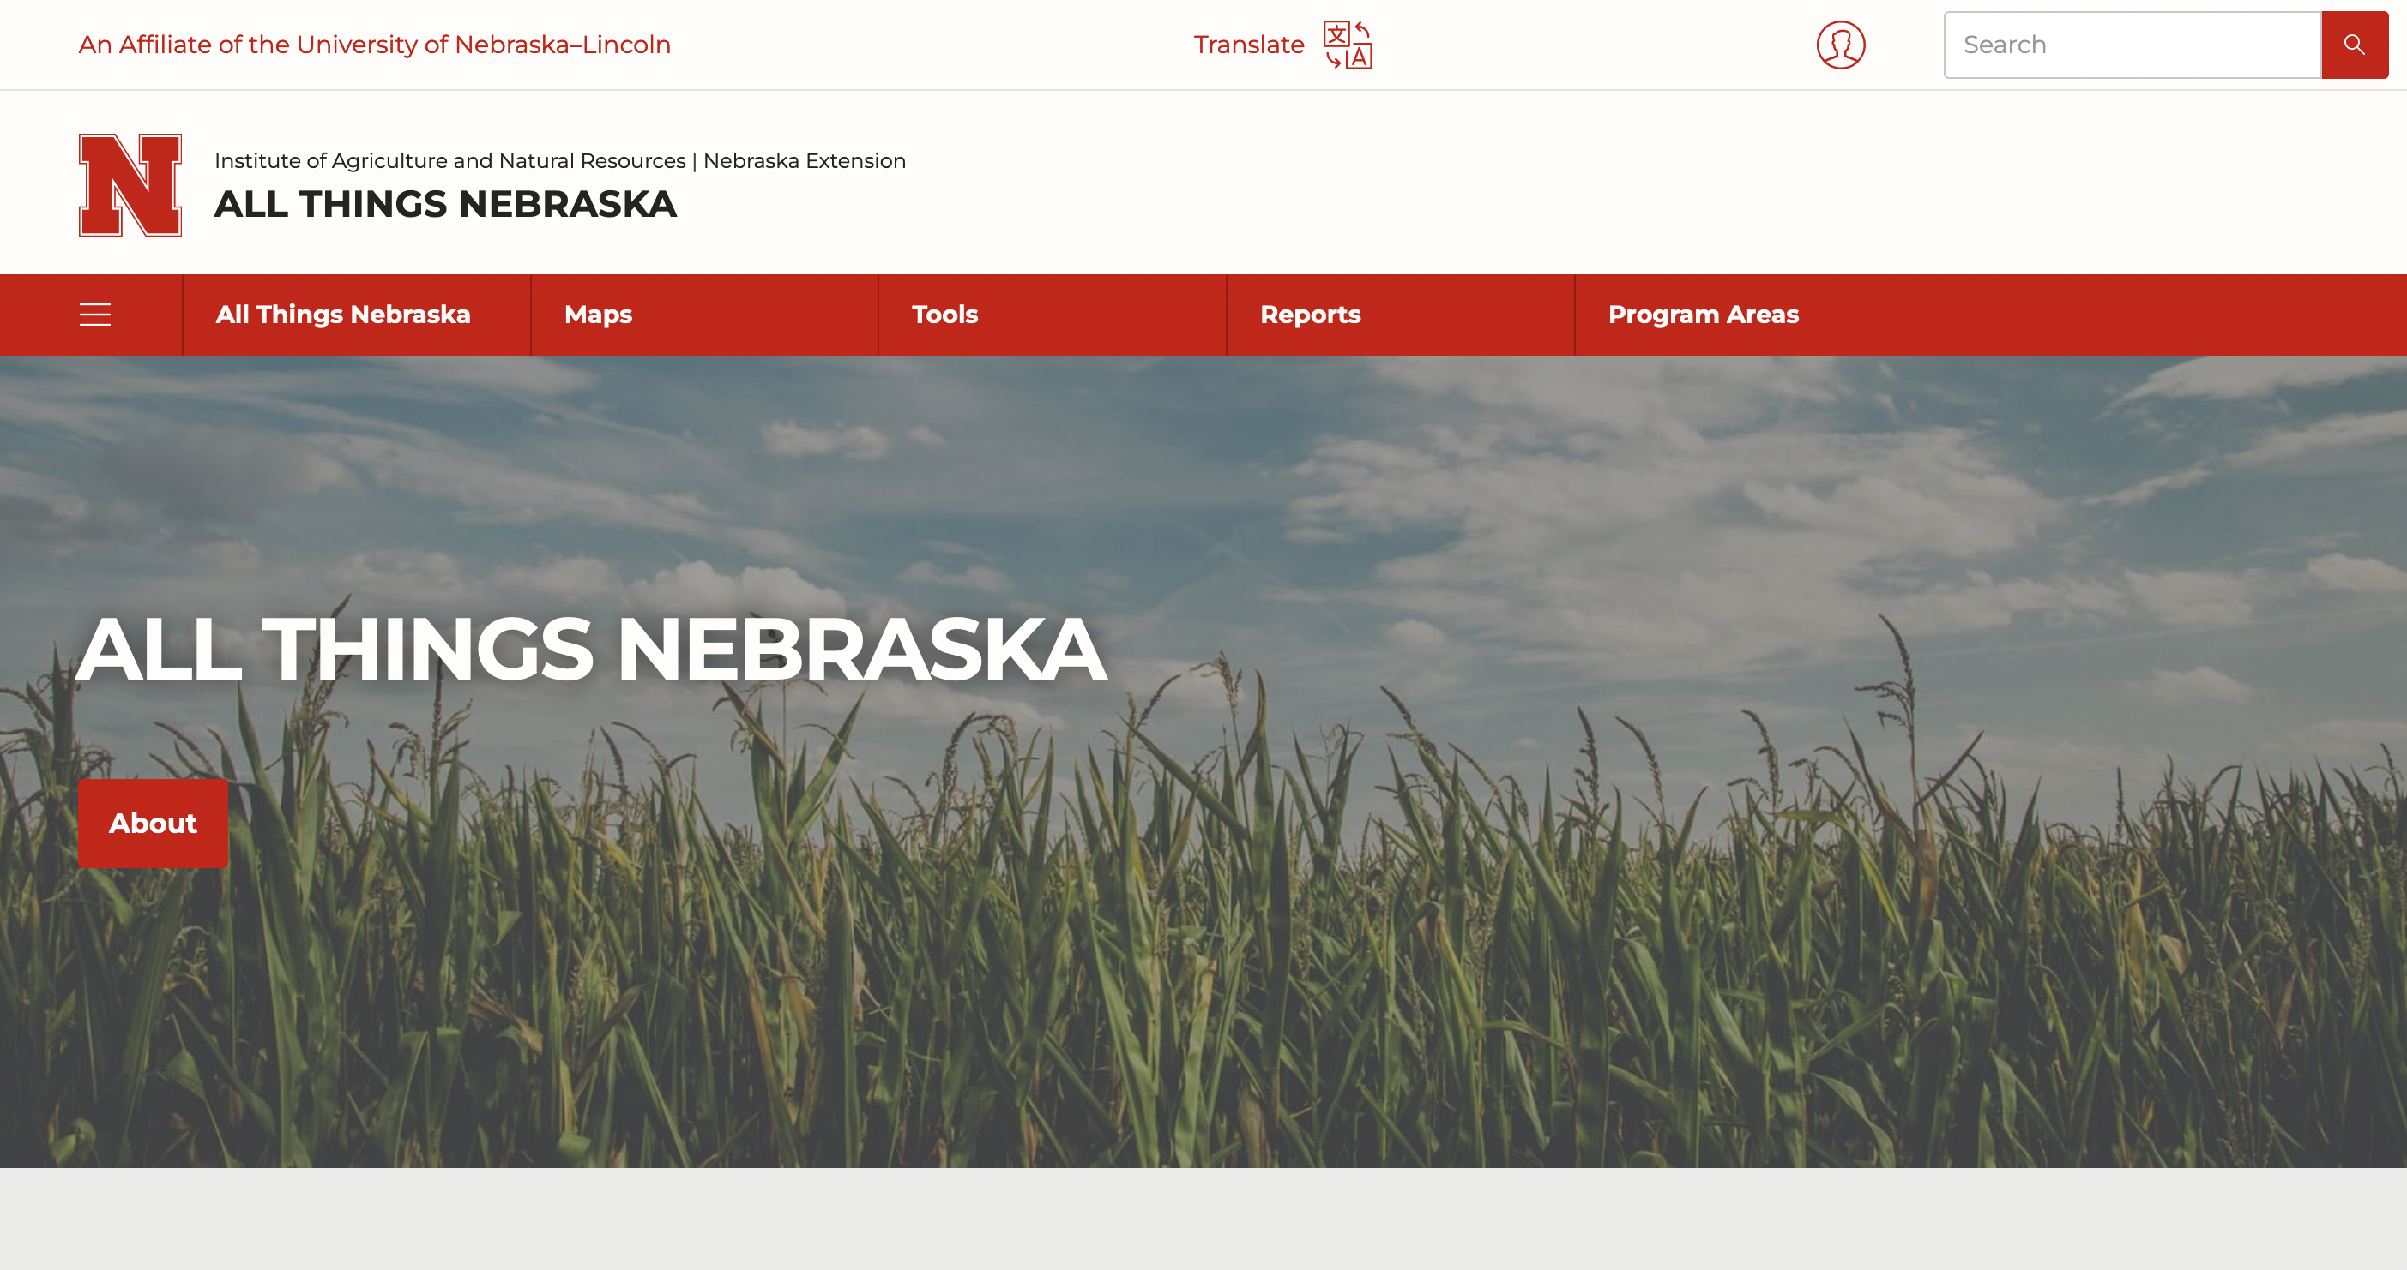


Slide 47
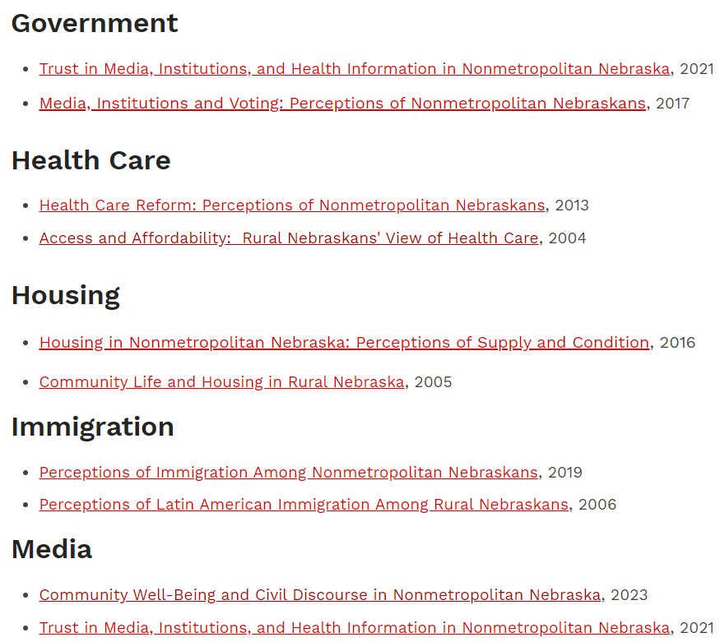

Finding Reports

Slide 48

Trust in Biosecurity Information Sources
“How much do you trust the following as sources of information about threats to the food supply or biosecurity?” (5-point scale)
Notes:
Heather

Slide 49
Opportunities for Collaboration
Purchasing questions on the Rural Poll
  Use in needs assessment and/or evaluation or programming
  Cost
    One Survey page (8.5” x 7”) of questions $6,500
    One half-page $4,000; Less than a half-page can be negotiated
    IRB approved; opportunity to make your data public
Contracting with the Rural Poll to conduct survey research
  Freedom to choose the sampling frame
  Contact Becky Vogt – Survey Manager – rvogt2@unl.edu
Using Rural Poll data for research
  Access data to conduct your own research
  30 years of data available for research
Serve as a panelists during Rural Poll webinars
Notes:
L.J.

Slide 50
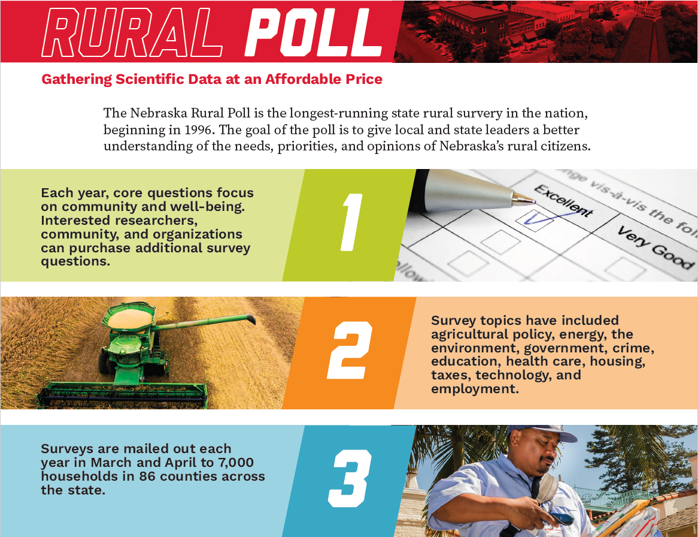
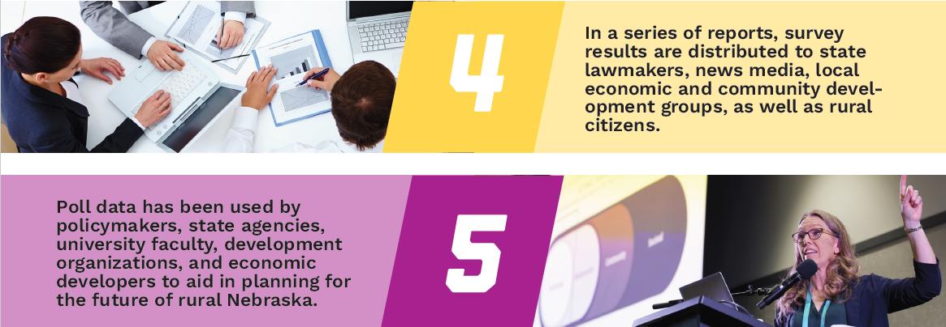

Slide 51
Title II Compliance: Digital Accessibility Update

Slide 52
Title II: Digital Accessibility Update
Status, Future Approach and Direction
The updated federal compliance enforcement date for Title II accessibility extended to April 26, 2027, providing additional time for review and remediation.
While regular office hours are currently paused, support efforts remain active, Paige Petersen and John Re will continue to assist with accessibility questions and provide updates.

Slide 53
Title II: Digital Accessibility Update
Status, Future Approach and Direction
Based on feedback, we are refining our approach to provide practical training, tools, and support that address identified needs while meeting accessibility requirements.
Your input will continue to guide this work. Expect additional communications and engagement opportunities in the coming weeks, and please continue using the accessibility resource site as new information, guidance, and materials will continue to be added.

Slide 54
NACEB Summer Conference

Slide 55
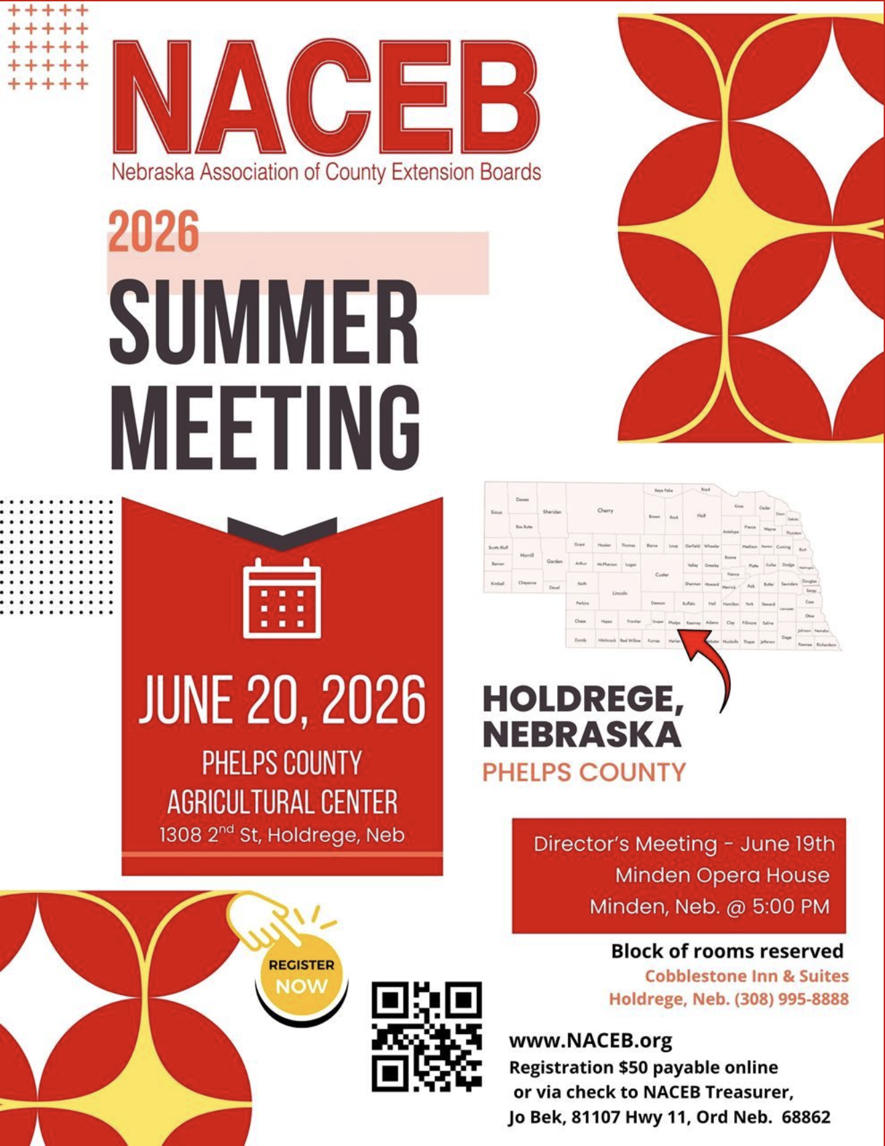
https://naceb.org
Is your county represented?
Register by June 12!

Slide 56
Extension Huddle Extra

Slide 57
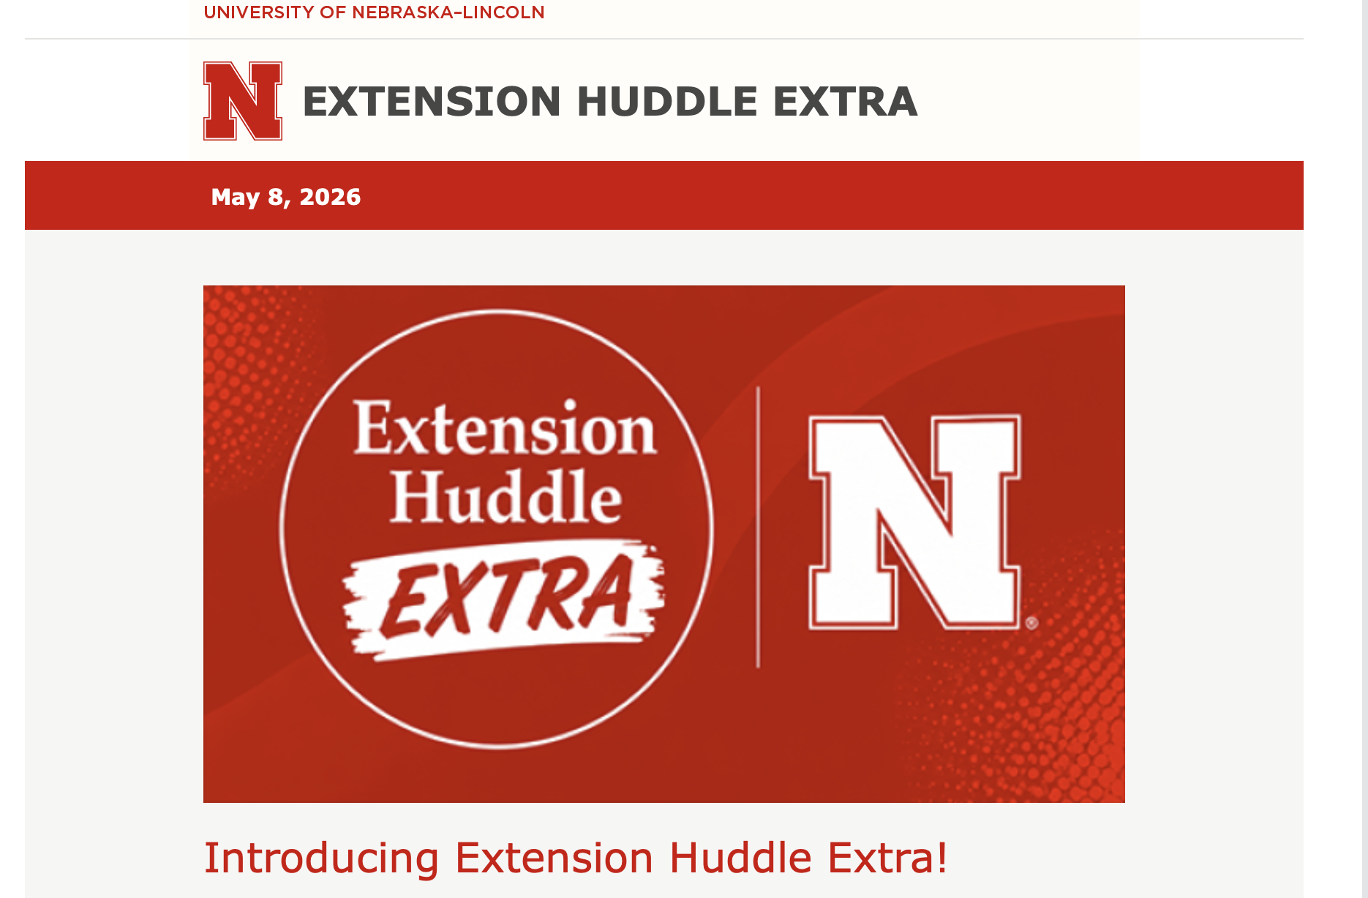

Slide 58
Questions?

Slide 59
Extension Huddle
May 21, 2026

